Slide 1
Weekly Hackathon: Day 3 Work Summary
Objective:
The focus for Day 3 of the weekly hackathon was to enhance the e-commerce project by implementing core functionality and refining data integration using Sanity.io.

Slide 2
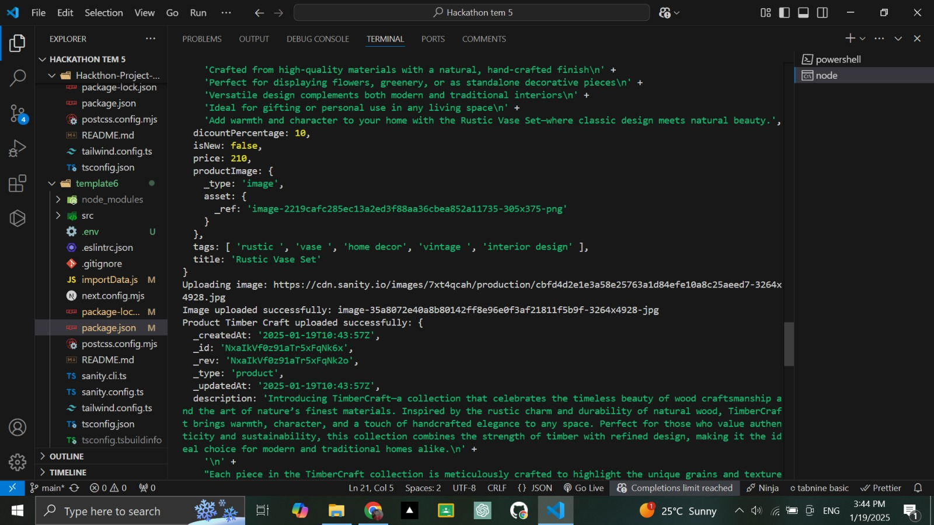

Slide 3
Tasks Accomplished: Sanity.io Integration:
Successfully connected the Sanity.io backend to the e-commerce frontend.
Queried the product dataset using GROQ.
Verified the dataset content through Sanity Vision, ensuring accurate retrieval of product information.
Updated the schema and content structure for products.

Slide 4
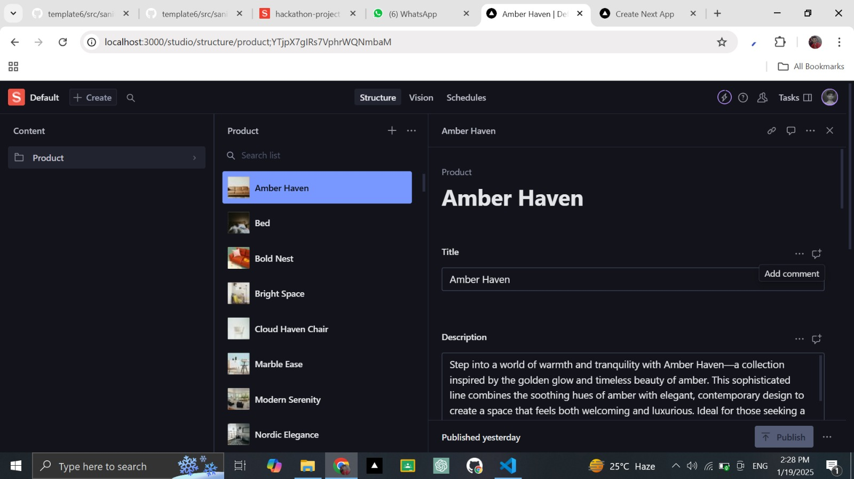

Slide 5
Challenges Faced:
Initial issues with missing environment variables.
Errors in the GROQ query that required debugging.

Slide 6
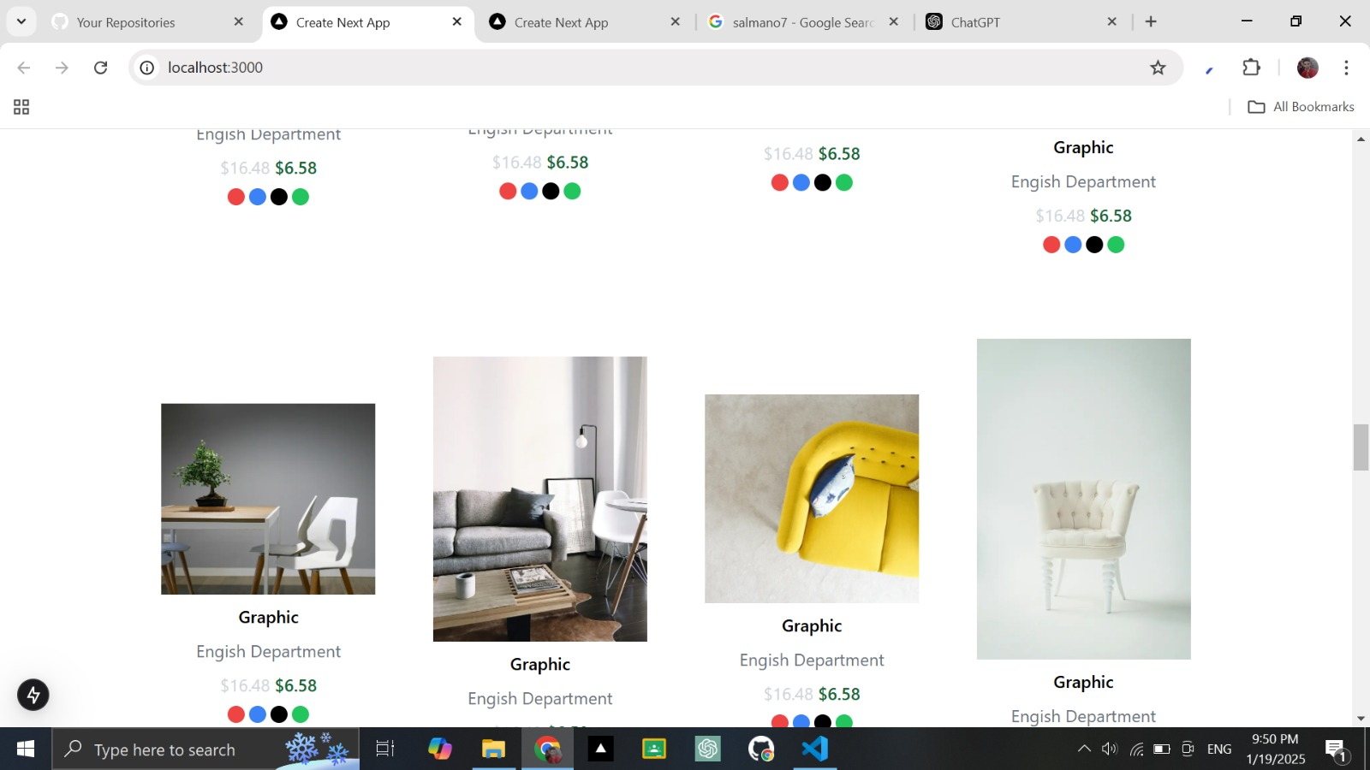

Slide 7
Tasks Completed
API Integration for Product Data
Integrated the Sanity.io API to fetch product data dynamically.
Configured the .env file to securely store the SANITY_DATASET, SANITY_PROJECT_ID, and SANITY_TOKEN for authentication.
Utilized the GROQ query *[_type == "product"][0..5] to fetch a limited set of products for initial display.

